Slide 1

Algebra 1
Unit 1, Lesson 6 Writing Equivalent Expressions Using Rational Exponents Volume 1, pg. 32

Slide 2


Benchmark
MA.912.NSO.1.1
Extend previous understanding of the Laws of Exponents to include rational exponents. Apply the Laws of Exponents to evaluate numerical expressions and generate equivalent numerical expressions involving rational exponents.
volume 1, pg. 32

Slide 3
Integrated Mathematical Thinking and Reasoning Standards
MA.K12.MTR.1.1 Actively participate in effortful learning both individually and collectively.
MA.K12.MTR.2.1 Demonstrate understanding by representing problems in multiple ways.
MA.K12.MTR.3.1 Complete tasks with mathematical fluency.
MA.K12.MTR.4.1 Engage in discussions that reflect on the mathematical thinking of self and others.
MA.K12.MTR.5.1 Use patterns and structure to help understand and connect mathematical concepts.
volume 1, pg. 32

Slide 4

Learning Targets
I can apply the Laws of Exponents to rational exponents.
I can convert between expressions involving rational exponents and expressions involving radicals.
volume 1, pg. 32

Slide 5

Warm-Up
volume 1, pg. 33

Slide 6
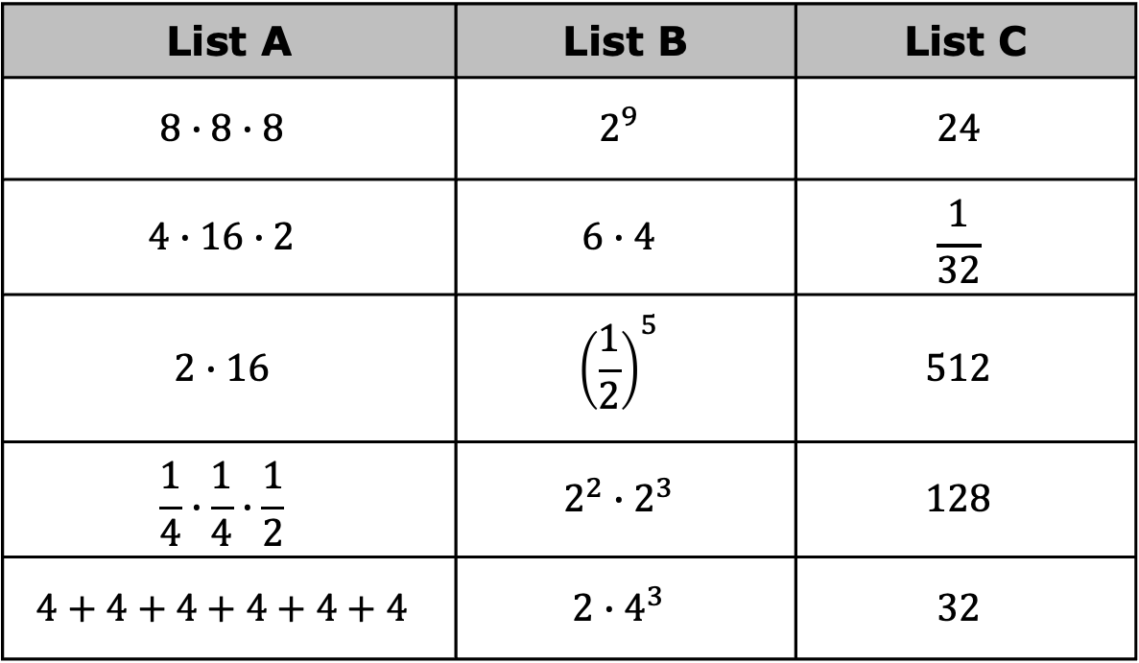
1.6.1 Warm-Up: Identifying Equivalent Expressions
Three lists of numbers are shown.
List A | List B | List C
$$8∙8∙8$$ | $$2^{9}$$ | $$24$$
$$4∙16∙2$$ | $$6∙4$$ | $$\frac{1}{32}$$
$$2∙16$$ | $${\left(\frac{1}{2}\right)}^{5}$$ | $$512$$
$$\frac{1}{4}∙\frac{1}{4}∙\frac{1}{2}$$ | $$2^{2}∙2^{3}$$ | $$128$$
$$4+4+4+4+4+4$$ | $$2∙4^{3}$$ | $$32$$
volume 1, pg. 33
Notes:
Video Link: https://algebranation.wistia.com/medias/fi4fidi5y8

Slide 7
Choose an expression from List A and match it with an equivalent expression from List B and List C.
Explain to your partner how you know the expressions you matched are equivalent.
Listen to your partner explain the match they found. If you disagree, discuss your thinking and work to reach an agreement.
volume 1, pg. 33

Slide 8

Guided Practice
volume 1, pg. 33

Slide 9

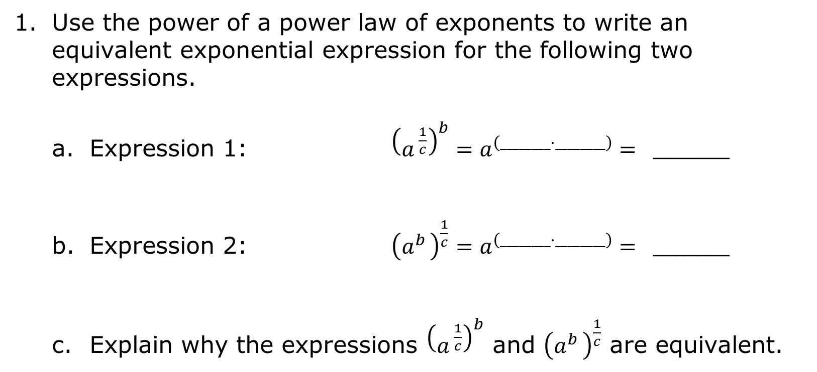
1.6.2 Guided Practice: Writing Equivalent Expressions
Use the power of a power law of exponents to write an equivalent exponential expression for the following two expressions.
Expression 1: ${\left(a^{ \frac{1}{c}}\right)}^{b}=a^{\left(________·________\right)}= _________$
Expression 2: ${\left(a^{b }\right)}^{\frac{1}{c}}=a^{\left(________·________\right)}= _________$
Explain why the expressions ${\left(a^{ \frac{1}{c}}\right)}^{b}$ and ${\left(a^{b }\right)}^{\frac{1}{c}}$ are equivalent.
volume 1, pg. 33

Slide 10
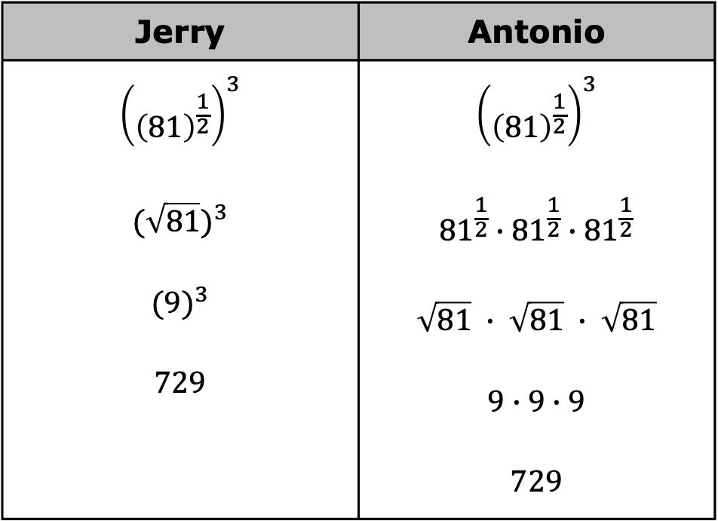
Two students evaluated an expression using two different methods.
Jerry | Antonio
$${\left({\left(81\right)}^{\frac{1}{2}}\right)}^{3}$$ $${(\sqrt{81})}^{3}$$ $${(9)}^{3}$$ $$729$$ | $${\left({\left(81\right)}^{\frac{1}{2}}\right)}^{3}$$ $${81}^{\frac{1}{2}}∙{81}^{\frac{1}{2}}∙{81}^{\frac{1}{2}}$$ $$\sqrt{81} ∙ \sqrt{81} ∙ \sqrt{81}$$ $$9∙9∙9$$ $$729$$
Explain the difference between the two methods.
volume 1, pg. 33

Slide 11

Exploration
volume 1, pg. 34

Slide 12

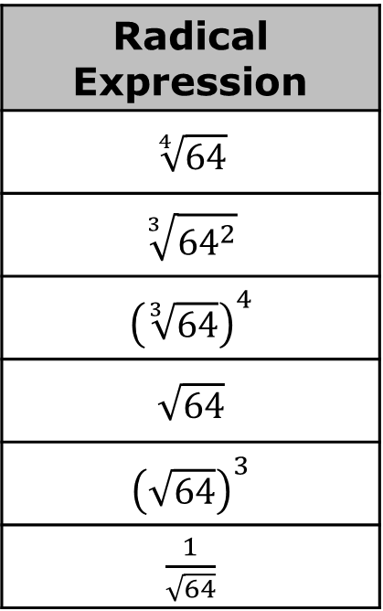
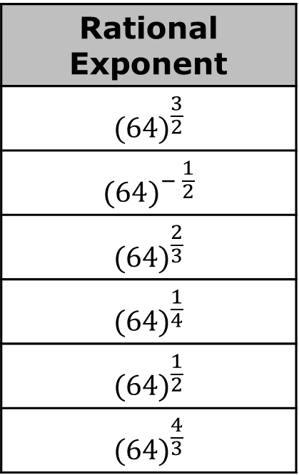
1.6.3 Exploration: Matching Expressions
Use your calculator to help you match each expression in the first table with an equivalent expression in the second table. Record your answers in the table below.
Rational Exponent
$${(64)}^{\frac{3}{2}}$$
$${(64)}^{− \frac{1}{2}}$$
$${(64)}^{\frac{2}{3}}$$
$${(64)}^{\frac{1}{4}}$$
$${(64)}^{\frac{1}{2}}$$
$${(64)}^{\frac{4}{3}}$$
Radical Expression
$$\sqrt[4]{64}$$
$$\sqrt[3]{{64}^{2}}$$
$${\left(\sqrt[3]{64}\right)}^{4}$$
$$\sqrt{64}$$
$${\left(\sqrt{64}\right)}^{3}$$
$\frac{1}{\sqrt{64}}$
volume 1, pg. 34

Slide 13
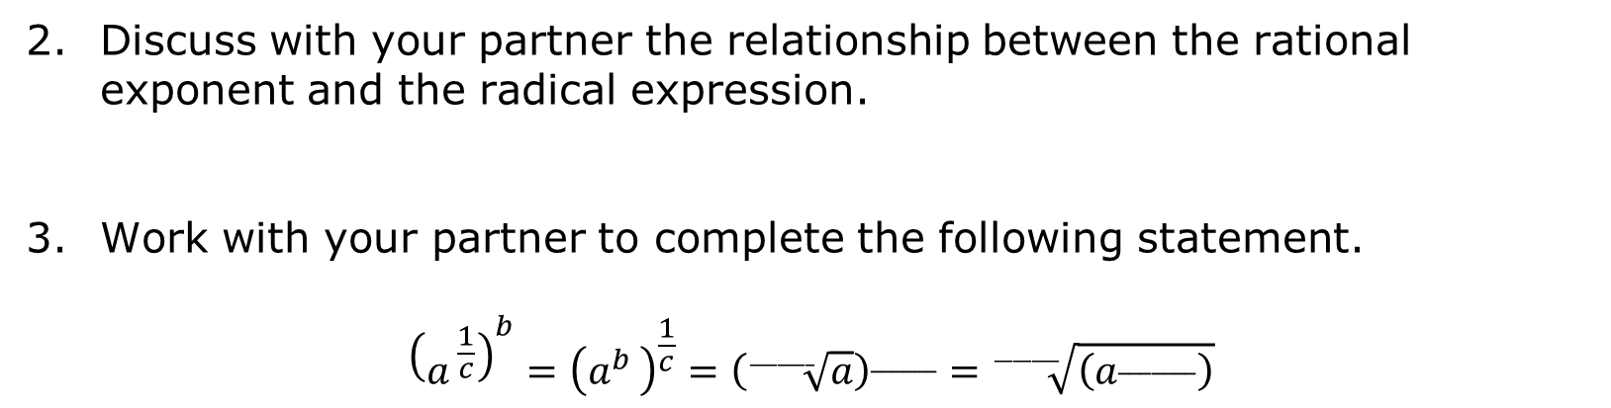
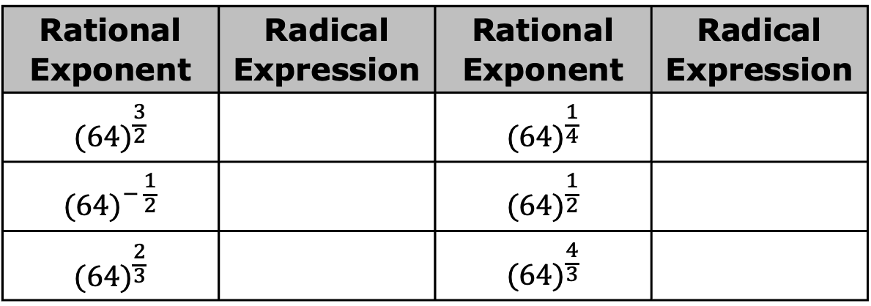
Rational Exponent | Radical Expression | Rational Exponent | Radical Expression
$${(64)}^{\frac{3}{2}}$$ |  | $${(64)}^{\frac{1}{4}}$$
$${(64)}^{− \frac{1}{2}}$$ |  | $${(64)}^{\frac{1}{2}}$$
$${(64)}^{\frac{2}{3}}$$ |  | $${(64)}^{\frac{4}{3}}$$
Discuss with your partner the relationship between the rational exponent and the radical expression.
Work with your partner to complete the following statement.
$${\left(a^{ \frac{1}{c}}\right)}^{b}={\left(a^{b }\right)}^{\frac{1}{c}}={\left(\sqrt[_______]{a}\right)}^{______}=\sqrt[_______]{\left(a^{_______}\right)}$$
volume 1, pg. 34

Slide 14

Activity
volume 1, pg. 34

Slide 15

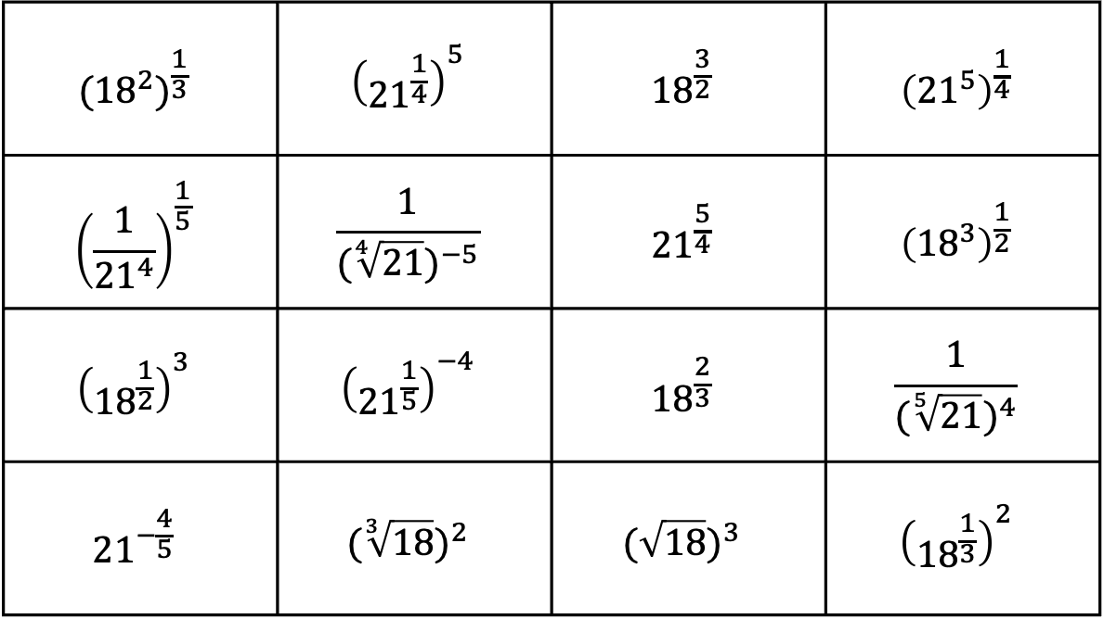
1.4.6 Activity: Card Sort
Work with your partner to sort the cards into sets of equivalent expressions.
$${({18}^{2})}^{\frac{1}{3}}$$ | $${\left({21}^{\frac{1}{4}}\right)}^{5}$$ | $${18}^{\frac{3}{2}}$$ | $${\left({21}^{5}\right)}^{\frac{1}{4}}$$
$${\left(\frac{1}{{21}^{4}}\right)}^{\frac{1}{5}}$$ | $$\frac{1}{{(\sqrt[4]{21})}^{−5}}$$ | $${21}^{\frac{5}{4}}$$ | $${\left({18}^{3}\right)}^{\frac{1}{2}}$$
$${\left({18}^{\frac{1}{2}}\right)}^{3}$$ | $${\left({21}^{\frac{1}{5}}\right)}^{−4}$$ | $${18}^{\frac{2}{3}}$$ | $$\frac{1}{{(\sqrt[5]{21})}^{4}}$$
$${21}^{−\frac{4}{5}}$$ | $${(\sqrt[3]{18})}^{2}$$ | $${(\sqrt{18})}^{3}$$ | $${\left({18}^{\frac{1}{3}}\right)}^{2}$$
volume 1, pg. 34

Slide 16
Record your matches below.
Equivalent Expression
volume 1, pg. 34

Slide 17

Try It
volume 1, pg. 35

Slide 18
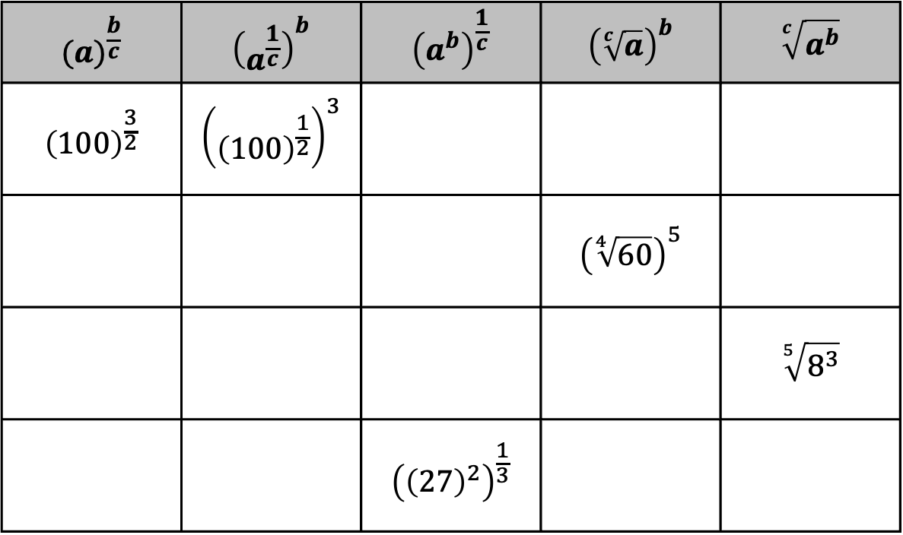
1.6.5 Try It: Writing Equivalent Expressions
Complete the table.
$${(a)}^{\frac{b}{c}}$$ | $${\left(a^{\frac{1}{c}}\right)}^{b}$$ | $${\left(a^{b}\right)}^{\frac{1}{c}}$$ | $${\left(\sqrt[c]{a}\right)}^{b}$$ | $$\sqrt[c]{a^{b}}$$
$${\left(100\right)}^{\frac{3}{2}}$$ | $${\left({\left(100\right)}^{\frac{1}{2}}\right)}^{3}$$
 |  |  | $${\left(\sqrt[4]{60}\right)}^{5}$$
 |  |  |  | $$\sqrt[5]{8^{3}}$$
 |  | $${\left({\left(27\right)}^{2}\right)}^{\frac{1}{3}}$$
volume 1, pg. 35

Slide 19
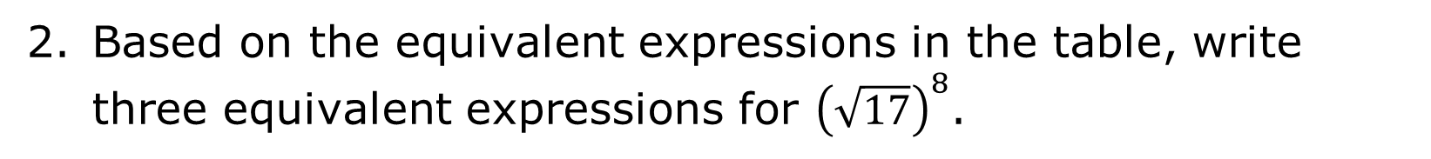
Based on the equivalent expressions in the table, write three equivalent expressions for ${\left(\sqrt{17}\right)}^{8}$.
volume 1, pg. 35

Slide 20

Your Turn
volume 1, pg. 35

Slide 21

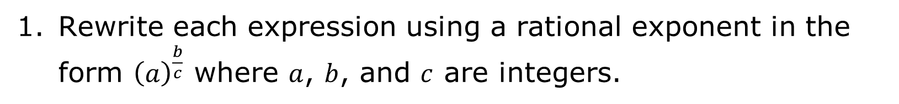
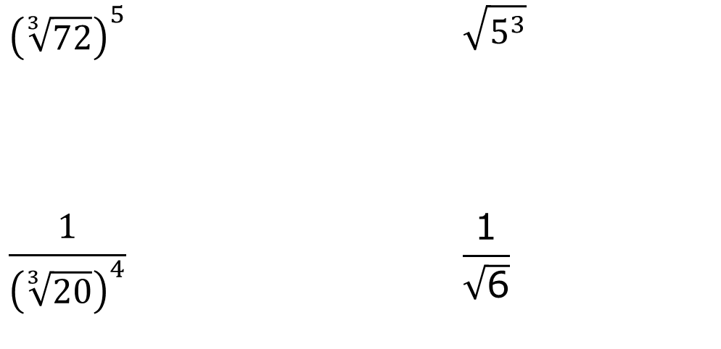
1.6.6 Your Turn!
Rewrite each expression using a rational exponent in the form ${\left(a\right)}^{\frac{b}{c}}$ where $a$, $b$, and $c$ are integers.
$${\left(\sqrt[3]{72}\right)}^{5}$$ | $$\sqrt{5^{3}}$$
$$\frac{1}{{\left(\sqrt[3]{20}\right)}^{4}}$$ | $$\frac{\text{1}}{\sqrt{\text{6}}}$$
volume 1, pg. 35

Slide 22

Wrap-Up
volume 1, pg. 36

Slide 23
1.6.7 Wrap-Up: Cool Down
Circle the expressions equivalent to ${\left({25}^{3}\right)}^{\frac{1}{2}}$.
$${\left(25\right)}^{\frac{3}{2}}$$ | $${\left(\sqrt{25}\right)}^{3}$$ | $${\left(25\right)}^{\frac{2}{3}}$$ | $${({25}^{\frac{1}{3}})}^{2}$$ | $$\sqrt{{25}^{3}}$$
volume 1, pg. 36

